Slide 1
COMP90007 Internet Technologies Workshop
Week 6
Ruixi
huor@student.unimelb.edu.au

Slide 2
Question 1
If there are n independent paths between two nodes in a network, and the probability that an individual path is working is p, what is the probability of these two nodes being connected? Assume path failures are independent.
Hint: first try to calculate what is the probability that all paths have failed
p
p
Answer:
P(nodes connected)
= 1 − P(all n paths failed)
= 1 − (1 − p)^{n}
p
p

Slide 3
Question 2
Give two example computer applications for which connection-oriented service is appropriate, and two examples for which connectionless service is best.

Slide 4
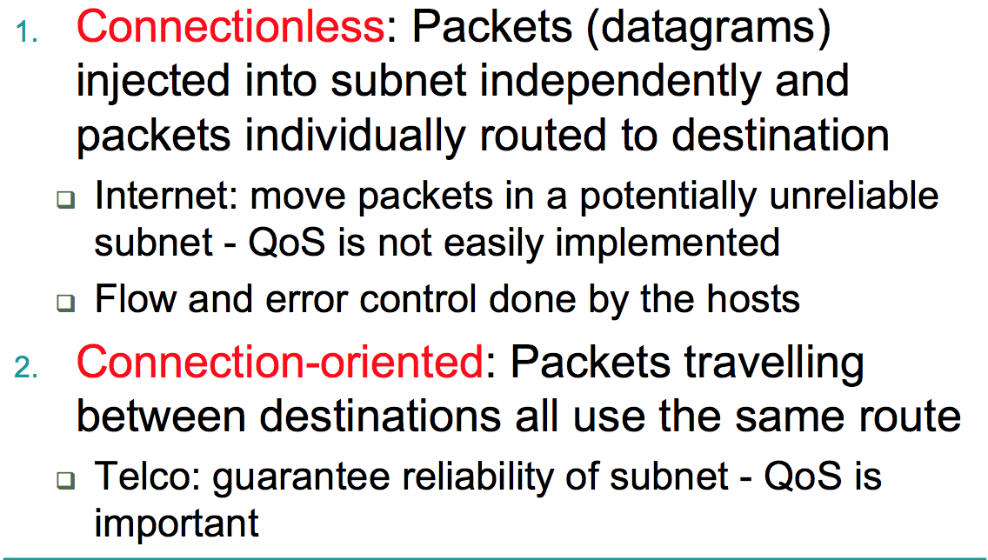
Network Layer Provide services to the Transport Layer
2 Types of Services

Slide 5
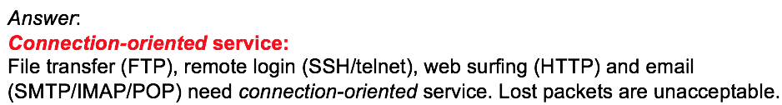
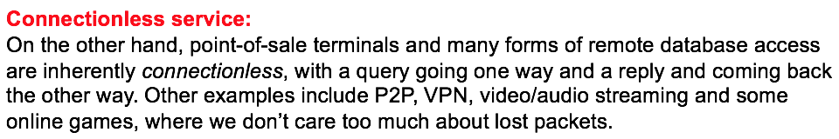
Question 2
Give two example computer applications for which connection-oriented service is appropriate, and two examples for which connectionless service is best.

Slide 6
Question 3
Assuming that all routers and hosts are working properly and that all software in both is free of all errors, is there any chance, however small, that a packet will be delivered to the wrong destination?

Slide 7
source
destination
checksum1
checksum2

Slide 8
Question 3
Assuming that all routers and hosts are working properly and that all software in both is free of all errors, is there any chance, however small, that a packet will be delivered to the wrong destination?
Answer:
Yes. A large noise burst could garble a packet badly
If the destination field, or equivalently, virtual circuit number is changed,
the packet will be delivered to the wrong destination and accepted as
genuine.
Put in other words, an occasional noise burst could change a
perfectly legal packet for one destination into a perfectly legal packet for
another destination.

Slide 9
Question 4
Is fragmentation needed in concatenated virtual-circuit internet or only in datagram systems?
Answer:
It is needed in both. Even in a concatenated virtual circuit network, some networks along the path might accept 1024-byte packets, and others might only accept 48-byte packets. Fragmentation is still needed.

Slide 10
Question 5
A router blasting out IP packets whose total length (header plus data) is 1024 bytes. Assuming that packets live for 10 sec, what is the maximum line speed the router can operate at without danger of cycling through the IP datagram ID number space (identification field – 16 bits)?

Slide 11
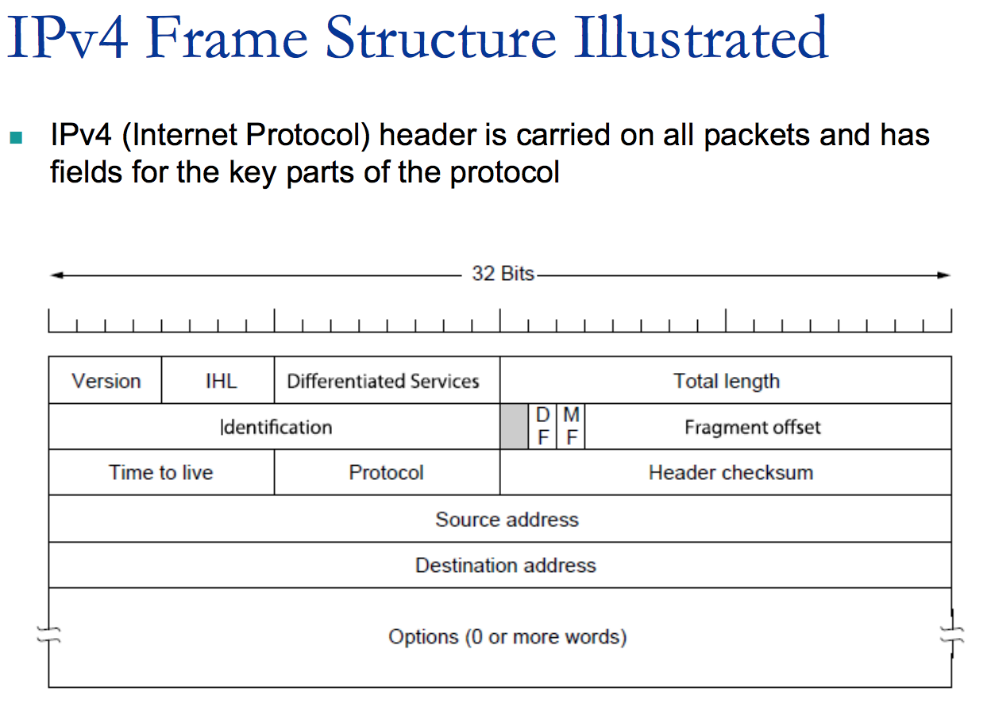
16 bits
2¹⁶ bits

Slide 12

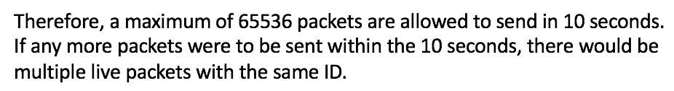
Question 5
A router blasting out IP packets whose total length (header plus data) is 1024 bytes. Assuming that packets live for 10 sec, what is the maximum line speed the router can operate at without danger of cycling through the IP datagram ID number space (identification field – 16 bits)?

Slide 13
Terminology
IP Address (32bits) has two components,
the network address and the host address.
Network
Host
A subnet mask separates the IP address into the network and host addresses, by setting network bits to all "1"s and setting host bits to all "0"s
If additional subnetwork is needed. Subnetting can further divide the host part of an IP address into a subnet and host address
Network
Subnet
Host

Slide 14
2 ways to represent IP addresses
1. Classful Network Address
2. CIDR (Classless Inter-Domain Routing)

Slide 15
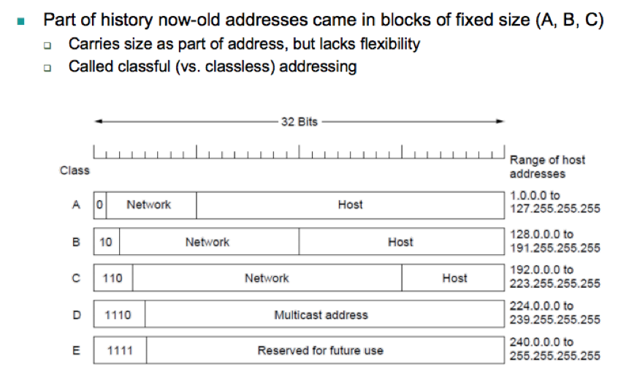
1. Classful Network Address
Such as 192.168.2.0
Default subnet mask
255.0.0.0
255.255.0.0
255.255.255.0

Slide 16
2. CIDR (Classless Inter-Domain Routing)
CIDR introduced a new method of representation for IP addresses
(known as CIDR notation)
Address or routing prefix is written with a suffix indicating the number of bits for network of the prefix.
Such as 192.168.5.130/24
24 bits for network address
Subnet mask

Slide 17
 | Binary form | Dot-Decimal notation
IP address | 11000000.10101000.00000101.10000010 | 192.168.5.130/24
Subnet mask | 11111111. 11111111.11111111.00000000 | 255.255.255.0
Network Address | 11000000.10101000.00000101.00000000 | 192.168.5.0/24
Host Address | 00000000. 00000000.00000000. 10000010 | 0.0.0.130

Slide 18
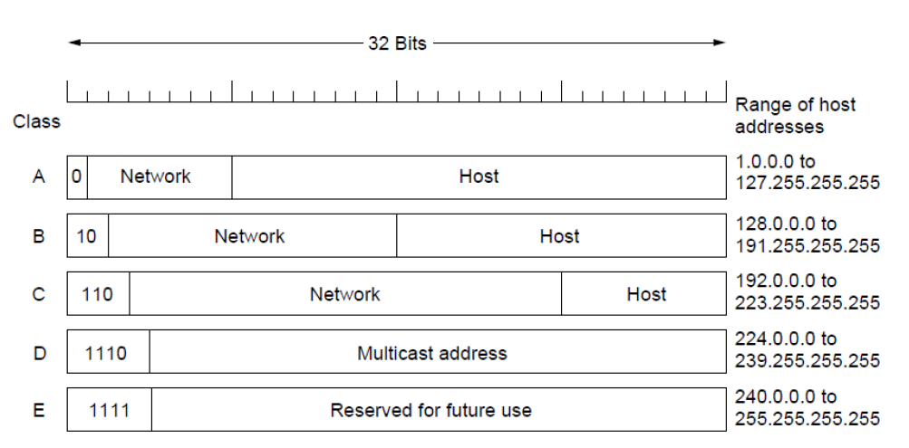
Question 6
Suppose that instead of using 16 bits for the network part of a class B address originally, 20 bits had been used. How many class B networks would there have been?
Answer:
With a 2-bit prefix, there would have been 18 bits left over to indicate the network. Consequently, the number of networks would have been 2¹⁸ or 262,144.

Slide 19
Question 9
A network on the Internet has a subnet mask of 255.255.240.0. What is the maximum number of hosts that it can handle?
Answer:
255.255.240.0 in binary is
11111111 11111111 11110000 0000000
The mask is 20 bits long, so the network part is 20 bits.
The remaining 12 bits are for the host, so 2¹² = 4096 host addresses exist.
You can also say there are 4096-2 = 4094 hosts.
Because the all 0s and all 1s are for special use.

Slide 20
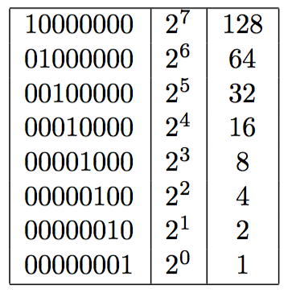
Question 7
Convert the IP address
11000001, 01010010, 11010010, 00001111
to dotted decimal notation.
Ans. 193.82.210.15

Slide 21
Question 8
Convert the IP address 240.68.10.10 to binary format
Use the following key:
Ans. 1111 0000 . 0100 0100 . 0000 1010 . 0000 1010

Slide 22
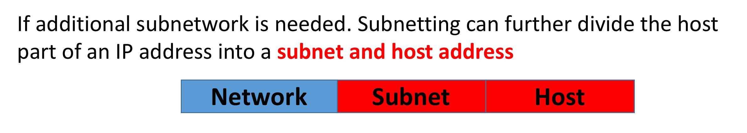
Subnetting
Subnetting allows the block of addresses to be split into several parts for internal use as multiple networks(organizations), while still acting like a single network to the outside world.
Host addresses must be consecutive

Slide 23
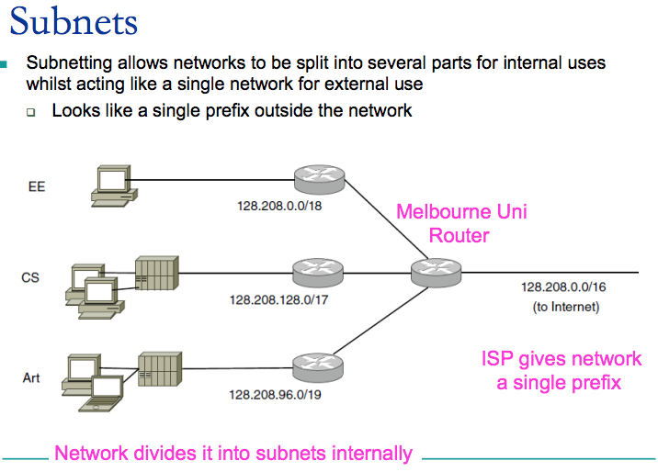

Slide 24
How to do subnetting?
Textbook Fig 5-50
Consider an example in which a block of 8192 (2¹³) addresses is available starting from 194.24.0.0
Order of the organizations: Cambridge(2048 = 2¹¹), Oxford(4096 = 2¹²) and Edinburgh(2048)
Cambridge:
Decimal notation
Binary format
194.24.0.0
11000010.00011000.00000000.00000000
194.24.7.255
11000010.00011000.00000111.11111111
21

Slide 25
How to do subnetting?
Textbook Fig 5-50
Consider an example in which a block of 8192 (2¹³) addresses is available starting from 194.24.0.0
Order of the organizations: Cambridge(2048 = 2¹¹), Oxford(4096 = 2¹²) and Edinburgh(2048)
Oxford:
Decimal notation
Binary format
194.24.8.0
11000010.00011000.00001000.00000000
194.24.15.255
11000010.00011000.00001111.11111111
2¹¹ < 2¹²

Slide 26
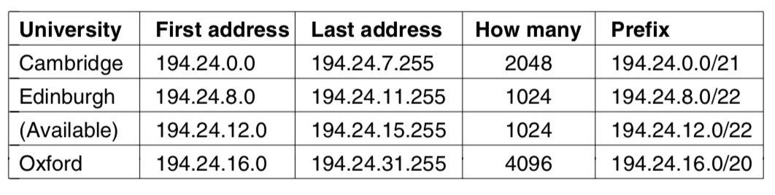
How to do subnetting?
Textbook Fig 5-50
Consider an example in which a block of 8192 (2¹³) addresses is available starting from 194.24.0.0
Order of the organizations: Cambridge(2048), Oxford(4096) and Edinburgh(2048)

Slide 27
If class C uses the subnet mask is 11111111.11111111.11111111.11100000,
How many subnets are allowed?
2³ = 8

